Slide 1
Customer Retention project
Naincy Dinesh Joshi

Slide 2
Q what is Customer Retention?
Ans Customer Retention is the process of retaining the old customer than the new ones.
Its very important to know why there is low retention rate.
There are many technique in ML where we can predict the churn rate of the customer

Slide 3
Customer retention is one of the most important problems in the 21 century. People have a lot of different products and services to choose from. It makes every E-retailer to fight a hard battle for the customer. Businesses spend a lot of resources and money to acquire a new customer. That is why it is important to keep existing customers. It is 5 times cheaper than finding a new one. All that to say, it is possible to reduce customer churn and increase customer retention using machine learning.
It means that investment in retention is one of the most important factors of business growth.

Slide 4
Machine Learning is a subset of AI used to build a mathematical model of sample data, known as “training data”, in order to make predictions or decisions without being explicitly programmed to perform the task.
Machine Learning gives you an opportunity to create self-learning models, which will have to make an appropriate task in the future e.g. predict customer churn, predict customer lifetime value (LTV), detect anomaly or fraud, etc. Both AI and machine learning are based on a solid foundation of big data science. AI, in order to work, needs a big amount of data that it can work with and on.

Slide 5
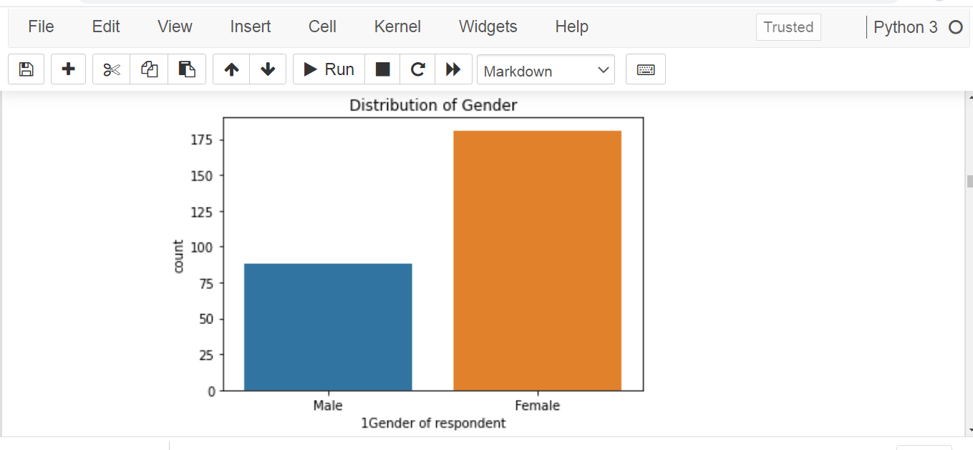
From the above barplot, we observe that the number of females is higher than the males.It means targeting “female” will leads to Lower customer churn rate.
Notes:
From the Above Graph, we can see that “Female” are more in the Dataset.It means Targeting “female” will leads to Higher customer churn rate.

Slide 6
Q why Female preferred more of online shopping than Male?
Ans When the name comes 'Shopping',it is always female who shops online or offline.They Find it easy and monetary saving while performing Online shopping.Anyone get attracted easily when they get offers.The main reason behind online shopping is discount, 'user friendly interface' and the enjoyment from online shopping.So to retain the customers,we can target the female,who are in majority to do online shopping.

Slide 7
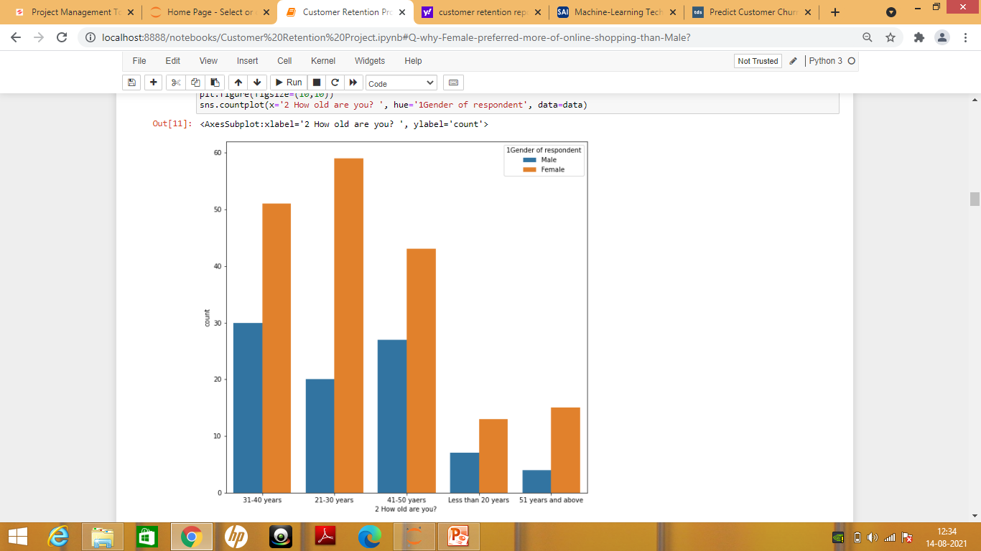
There are more people who shops online in the age-group of "21-30" and in every age-group 'Females' are more

Slide 8
Need of Customer Segmentation
It will help in identifying the most potential customers.
It will help managers to easily communicate with a targeted group of the audience.
Also, help in selecting the best medium for communicating with the targeted segment.
It improves the quality of service, loyalty, and retention.
Improve customer relationship via better understanding needs of segments.
It provides opportunities for upselling and cross-selling.
It will help managers to design special offers for targeted customers, to encourage them to buy more products.
It helps companies to stay a step ahead of competitors.
It also helps in identifying new products that customers could be interested in.

Slide 9
Customer segmentation is useful in understanding what demographic and psychographic sub-populations there are within your customers in a business case.
1.Getting started, you can write out your import statements and load the data set, calling head() to see a preview of the data.

Slide 10
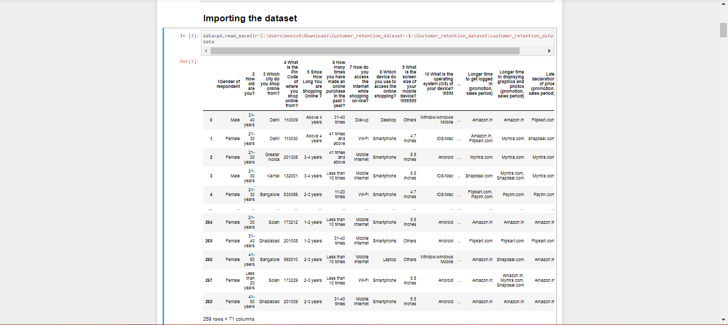
Data Preparation
Data.head() will give top of the data

Slide 11
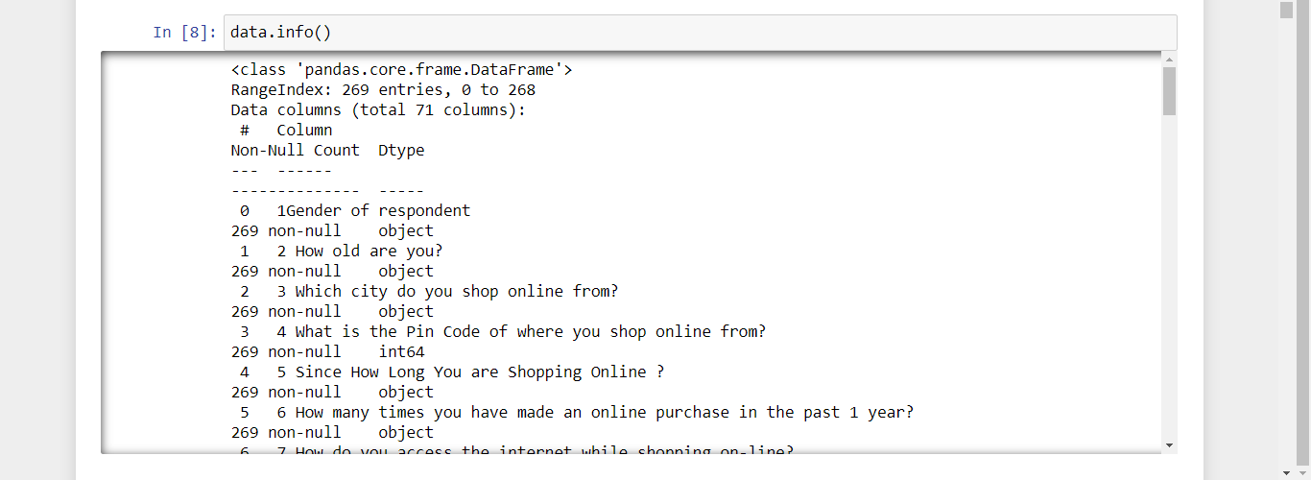
Raw Description

Slide 12
Data.info() will provide information about the column details i.e what type of column is available.It will also give information about the column ‘Datatypes’.
Data.describe() will provide information about mean,standard mean.It also give information about quantile percentage of different columns.
Data.isna().sum() will give you information about the missing value in the dataset.

Slide 13
Q Why Product Value Is a Necessary Condition for Customer Retention?
Sol:-Product value is the primary driver for customer retention.
If a customer is dissatisfied with their purchase, they are unlikely to come back. But even beyond that simple statement, it turns out product value creates loyalty.
64% – Of customers identify value for money as an important factor in brand loyalty.
50% – Agree that if a brand offers the best quality products and services they will purchase again.

Slide 14
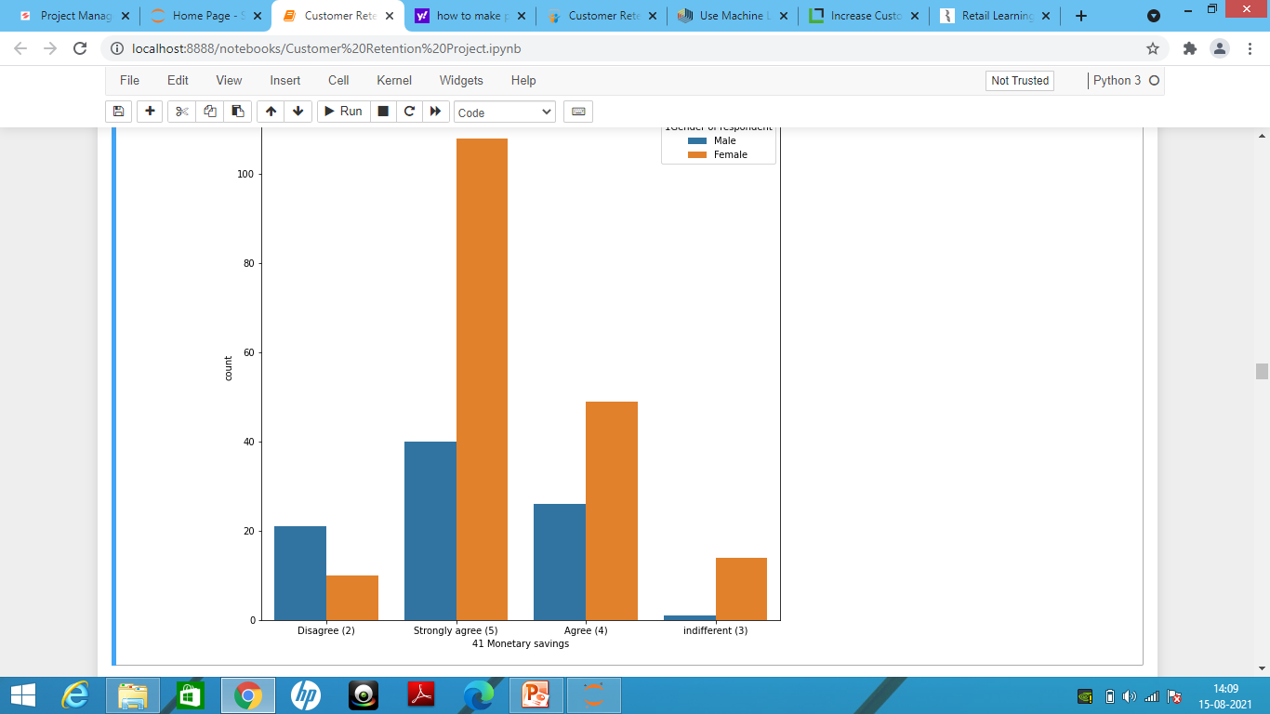
How people Think about monetary saving while shopping online.

Slide 15
Q Personalized Customer Experiences Are Increasingly Necessary?
A Customers don’t want to look through countless uninteresting items.
They want personal offers – relevant to them in this moment. They want products they care about.
Today, e-Retail stores can create personalized product recommendations, leverage dynamic content, and even tailor specific rewards down to the individual.

Slide 16
WE will use LabelEncoder() to convert ‘object’ datatype into integer
To convert “Object” datatype, we can use LabelEncoder,OneHotEncoder into categorical data,so that we can perform statistical calculation on splitting the data into “X” as a features and “Y” as a label or a vector

Slide 17
We can split the data into train_test_split
The train_test_split function is for splitting a single dataset for two different purposes: training and testing. The testing subset is for building your model. The testing subset is for using the model on unknown data to evaluate the performance of the model.

Slide 18
Building The Model

Slide 19
Hyper_parameter Tunning
Hyperparameter tuning is an important step for improving algorithm performance. It tests various parameter combinations to come up with the most optimized set of parameters. In this post,we covered hyperparameter tuning in Python using the scikit-learn library.
We improved algorithm results significantly using grid search.We took Knn model because there is a least difference of accuracy_score and the cross_validation_score

Slide 20
ROC_AUC_CURVE
AUC - ROC curve is a performance measurement for the classification problems at various threshold settings. ROC is a probability curve and AUC represents the degree or measure of separability. It tells how much the model is capable of distinguishing between classes. Higher the AUC, the better the model is at predicting 0 classes as 0 and 1 classes as 1. By analogy, the Higher the AUC, the better the model is at distinguishing between customer retention and with no retention

Slide 21
The ROC curve is plotted with TPR(True positive rate) against the FPR(false positive rate) where TPR(True positive rate) is on the y-axis and FPR(False positive rate) is on the x-axis.
Saving And Loading the Model:-
We can save the model through various process
Save Your Model with pickle.
Save Your Model with joblib.
object serialization This process / procedure of saving a ML Model is also known as object serialization - representing an object with a stream of bytes, in order to store it on disk, send it over a network or save to a database.
deserialization While the restoring/reloading of ML Model procedure is known as deserialization.

Slide 22
CONCLUSION:-
Knowing your customer is crucial. Digital shopping provides businesses with an increasing potential customer base. It has also created a highly educated consumer that can compare all competitive products / services with a few clicks. Focused marketing and customer interaction is key to keeping a loyal customer and generating new business as well. We need to analyze who their current customers are, where their potential customers are and how to keep them all happy. Transaction and demographic data generated at point-of-sale, through marketing tactics and through loyalty programs provides a wealth of retail data prime for analysis. One example, the data can be used to forecast demand for individual geographic areas.

Slide 23
Armed with this knowledge, retailers can be proactive and able to fulfil orders more quickly and efficiently. This is a great way to keep your customers happy.
Returning to insights driven marketing and merchandising, data on how individual customers interact and make contact with retailers can then be used to decide which is the best way to grab their attention with a particular product or promotion.
Analysing and tracking this data through professional dashboards is a great way for customer retention of any size to stay ahead of the pack.

